Slide 1
OpenShift Monitoring and Logging

Slide 2
Definitions
Logs
Information from discrete events
Unstructured text
may be formatted (syslog, common log, …)
Structured (e.g. json)
Timestamped (?)
Text search, query + reduce
Logging = collecting and analyzing log data
Monitoring = collecting and analyzing metrics
Note: both systems can, must and do support generating alerts
Metrics
Observables (CPU, memory, threads …)
Measured on specific intervals
every 10ms, 1s, 5mins …
Time series of data
Time-based graphs, gauges, charts

Slide 3
Application logging
Application
/var/log/myapp
Filesystem

Slide 4
Container logging -incorrect
Container logging
Application
/var/log/myapp
Container runtime

Slide 5
Container logging 12-factor
Application
stdout / stderr
Container runtime

Slide 6
Kubernetes logging
Worker
Application
Application
Scaling to a cluster of multiple applications
Application output – what is written to stdout / stderr
and…
Context in cluster:
Namespace
Worker node
Pod name
Container in pod
Labels
Container runtime
/var/log
Deleted on pod eviction
oc logs stockquote-1-4ld88 –n mcsvcs-user001

Slide 7



Log management with EFK
EFK stack to aggregate logs for hosts and applications
Elasticsearch: search and analytics engine
Fluentd: gathers logs and sends to Elasticsearch
Kibana: web UI for Elasticsearch
Access control
Cluster administrators can view all logs
Users can only view logs for their projects
Ability to send logs elsewhere
External Elasticsearch, Splunk, etc
EFK is the default for OpenShift, other options:
ElasticSearch, Logstash, Kibana (ELK)
LogDNA – cloud log storage provider

Slide 8
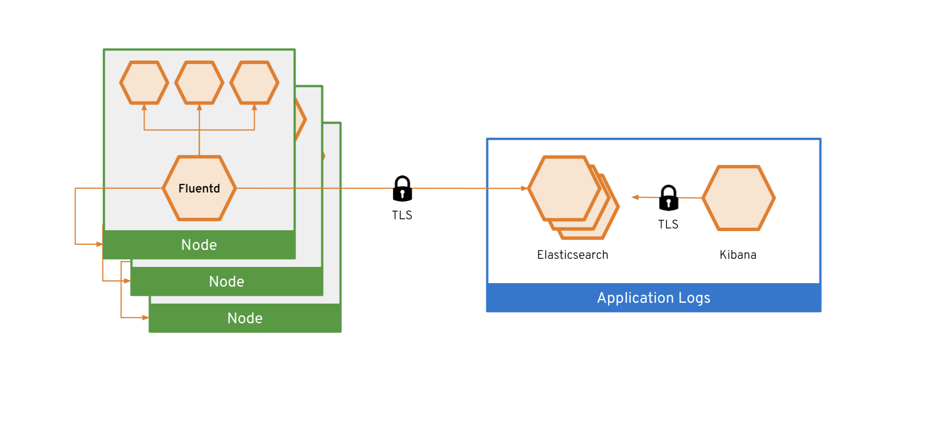
EFK Log access

Slide 9
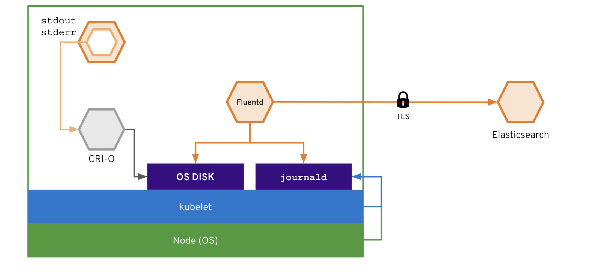
Log capture to Elastic

Slide 10
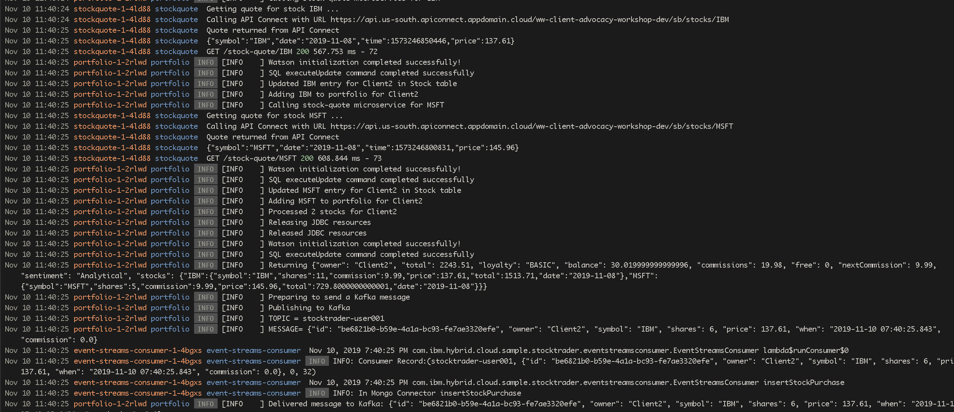
Aggregated logs

Slide 11
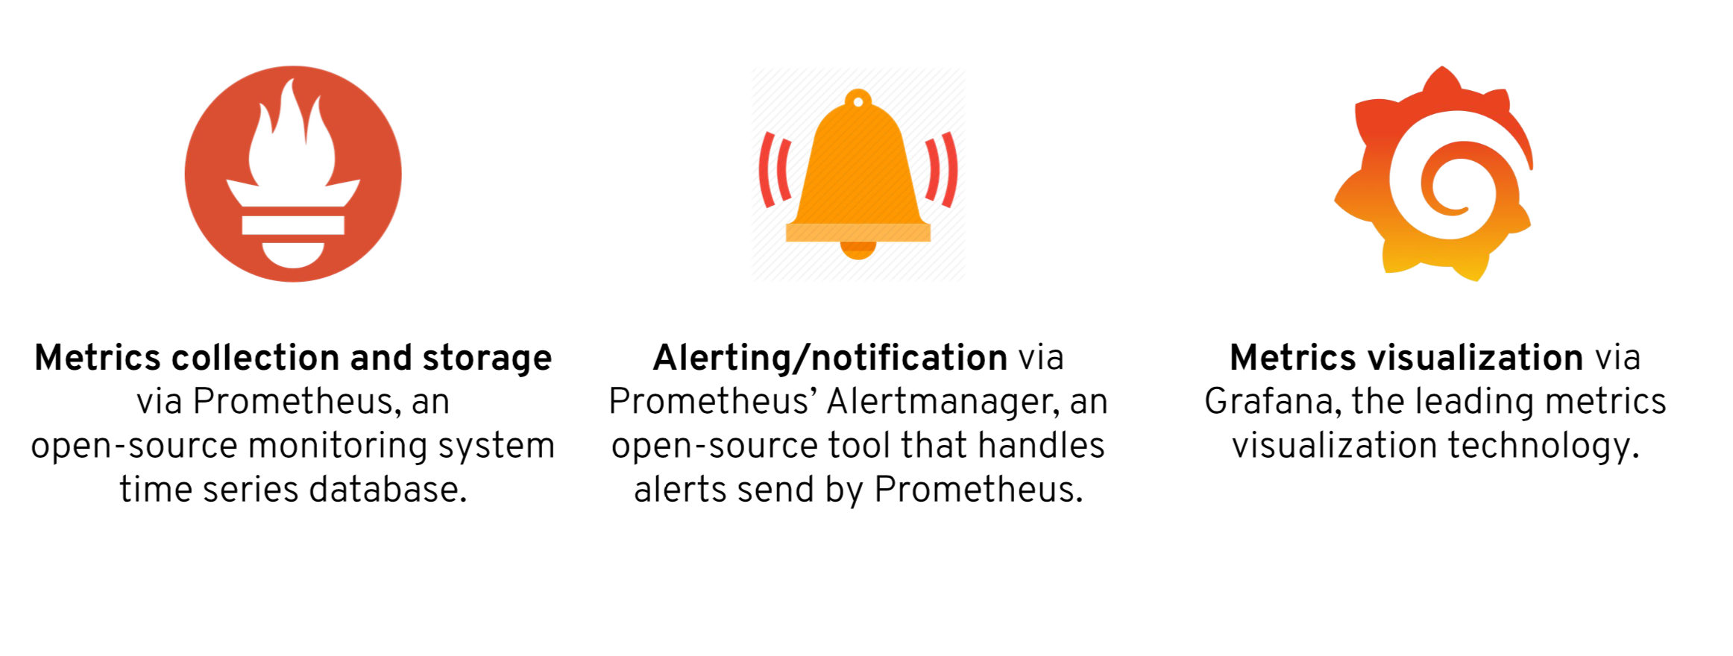
OpenShift Cluster Monitoring

Slide 12
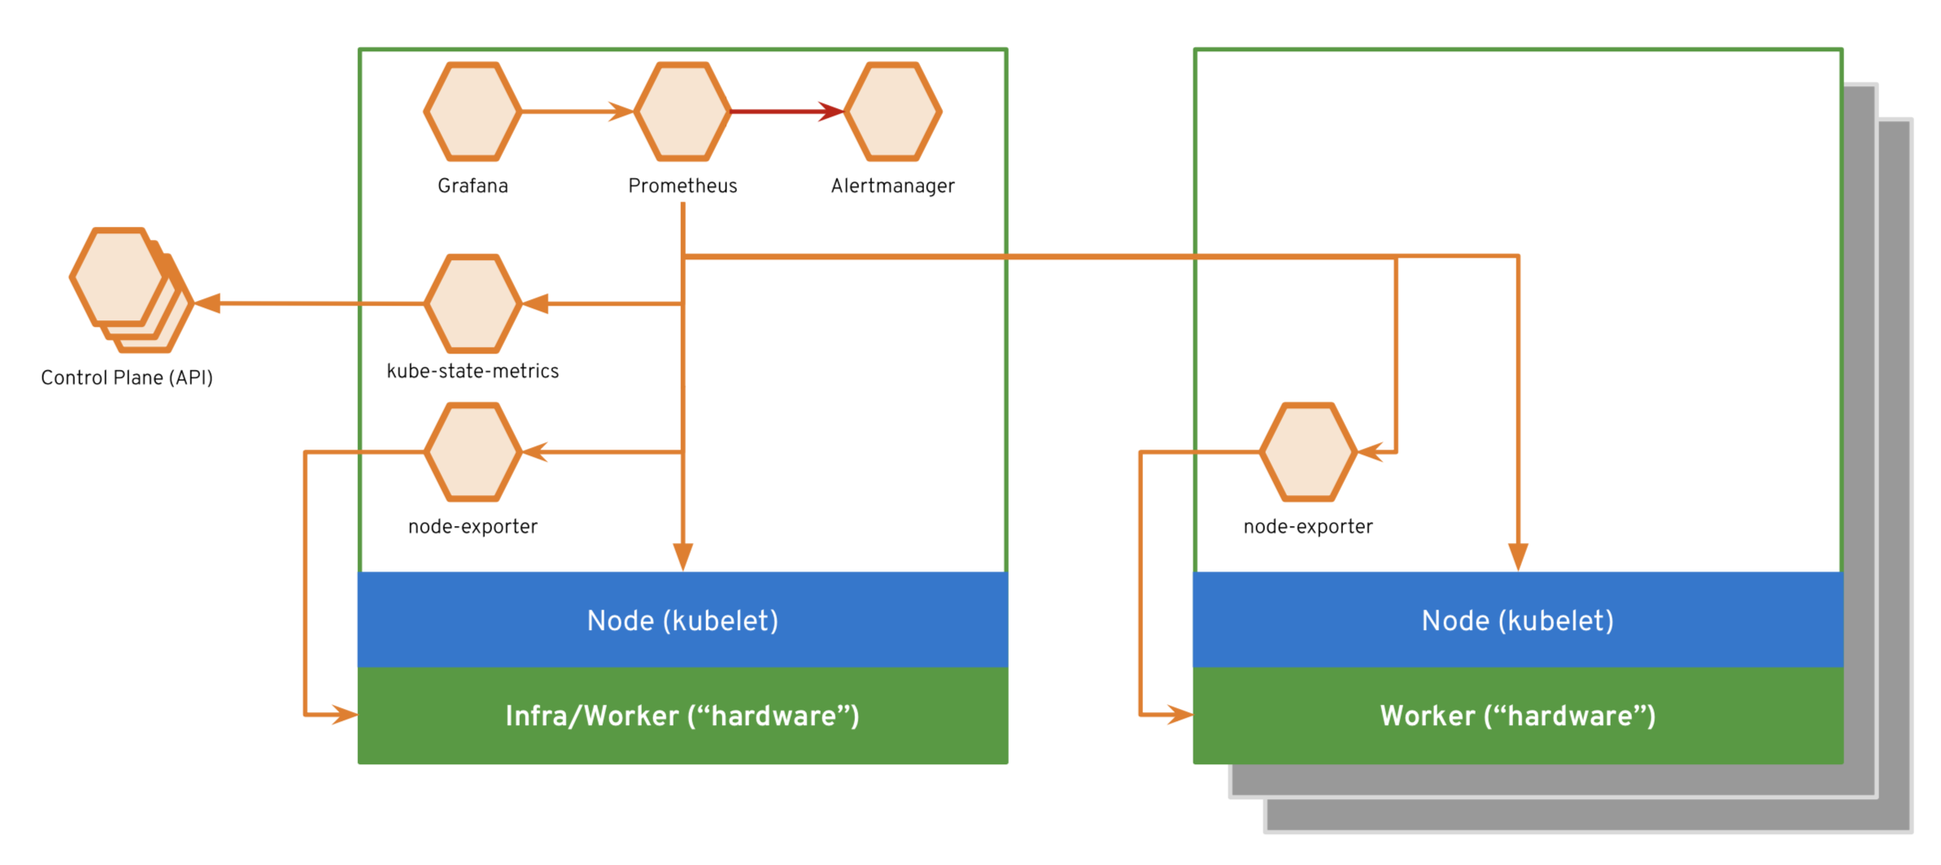
Architecture
Prometheus uses a “scraping” model – polling targets vs. push by agents

Slide 13
Prometheus Data Model
What is a time series?
<identifier> → [ (t0, v0), (t1, v1), … ]
what resource
int64
float64

Slide 14
Prometheus Data Model
Identifiers in a time series?
container_memory_usage_bytes{namespace="mcsvcs-user001",pod_name="trade-history-1-f9h5w"}
metric name
labels
Flexible - could be anything
No hierarchy
Human readable

Slide 15
Prometheus Rules
Recording rules allow the definition of complex or frequently needed expressions
record: pod_name:container_cpu_usage:sum
expr: sum
by(pod_name, namespace) (rate(container_cpu_usage_seconds_total{container_name!="",container_name!="POD",pod_name!=""}[5m]))

Slide 16
Prometheus Querying
How many pods in namespace mcsvcs-001 are running at more than 0.01 CPU (10 milicores)?
pod_name:container_cpu_usage:sum{namespace="mcsvcs-user001"} > 0.01
pod_name:container_cpu_usage:sum{namespace="mcsvcs-user001", pod_name="mongodb-1-xgbqr"} | 0.018
pod_name:container_cpu_usage:sum{namespace="mcsvcs-user001", pod_name="trade-history-1-f9h5w"} | 0.020

Slide 17
Prometheus Alerts
Generate an alert when a node is project to run out of storage
alert: NodeDiskRunningFull
expr: '(node:node_filesystem_usage:
> 0.85) and (predict_linear(node:node_filesystem_avail:[30m], 3600 * 2) <
0)'
for: 10m
labels:
severity: critical
annotations:
message: Device {{ $labels.device }} of node-exporter {{ $labels.namespace }}/{{
$labels.pod }} is running full within the next 2 hours.

Slide 18
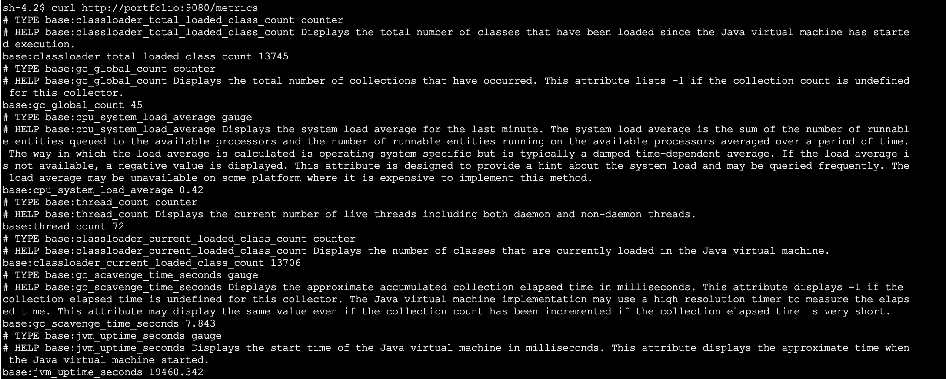
Application monitoring
Pre-configured for cluster monitoring, but Prometheus is commonly used for applications too

Slide 19
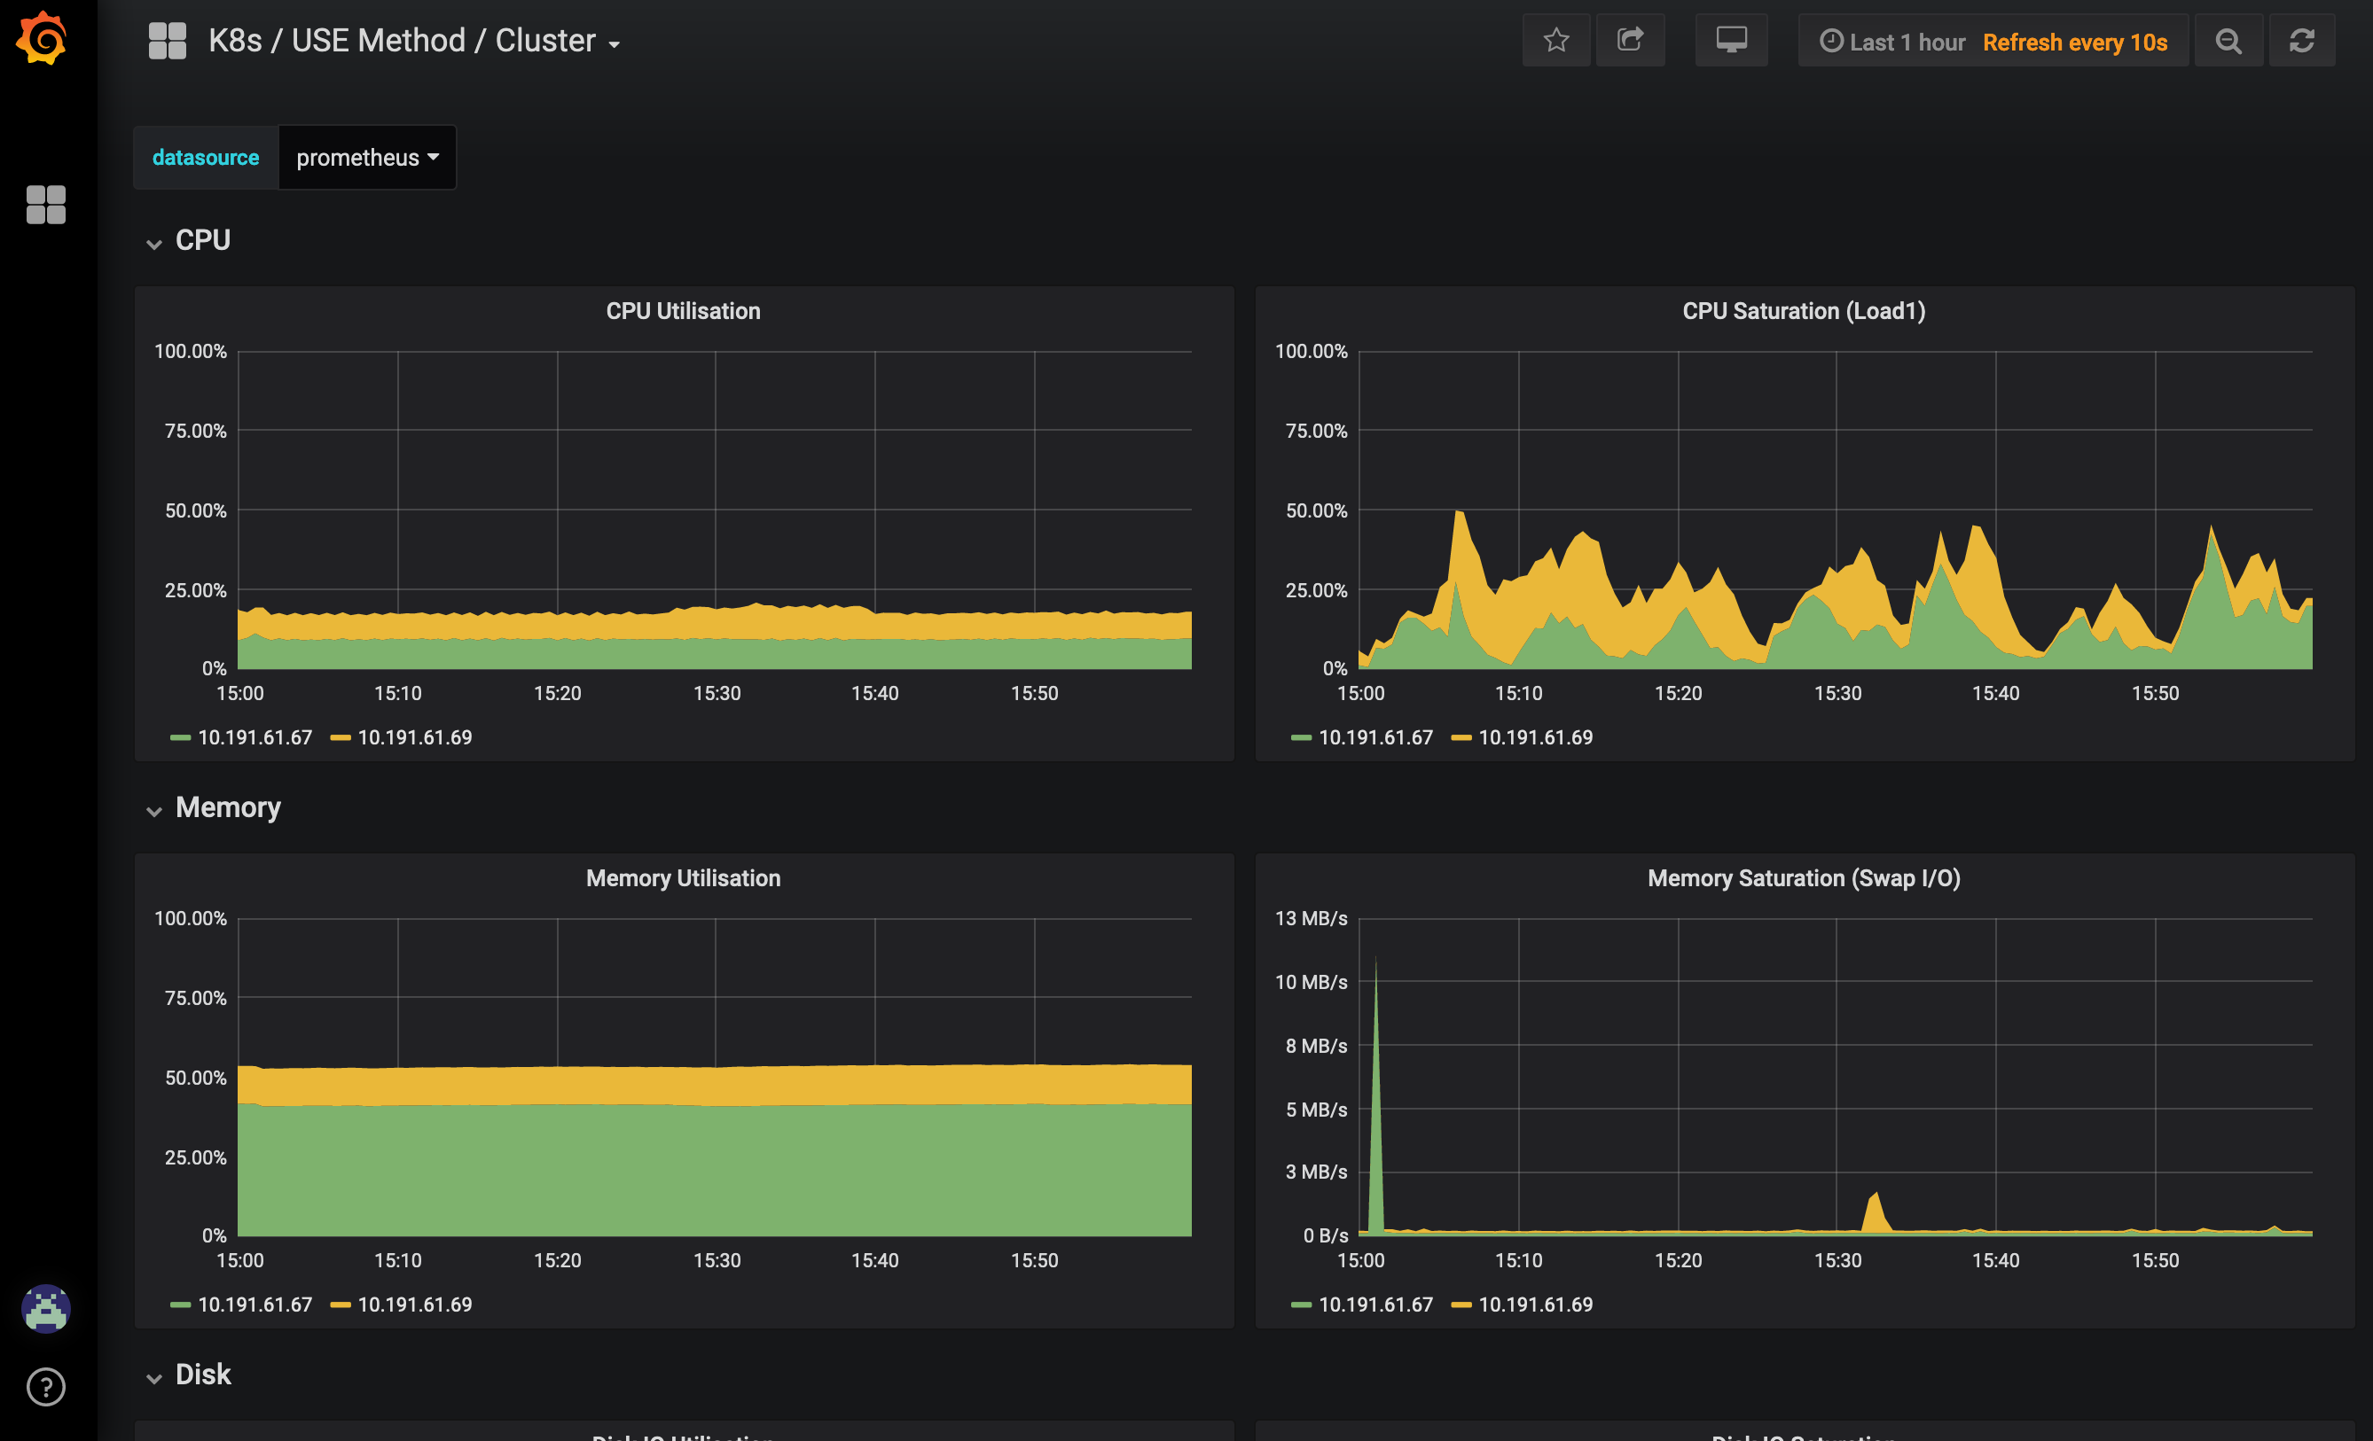
Grafana

Slide 20
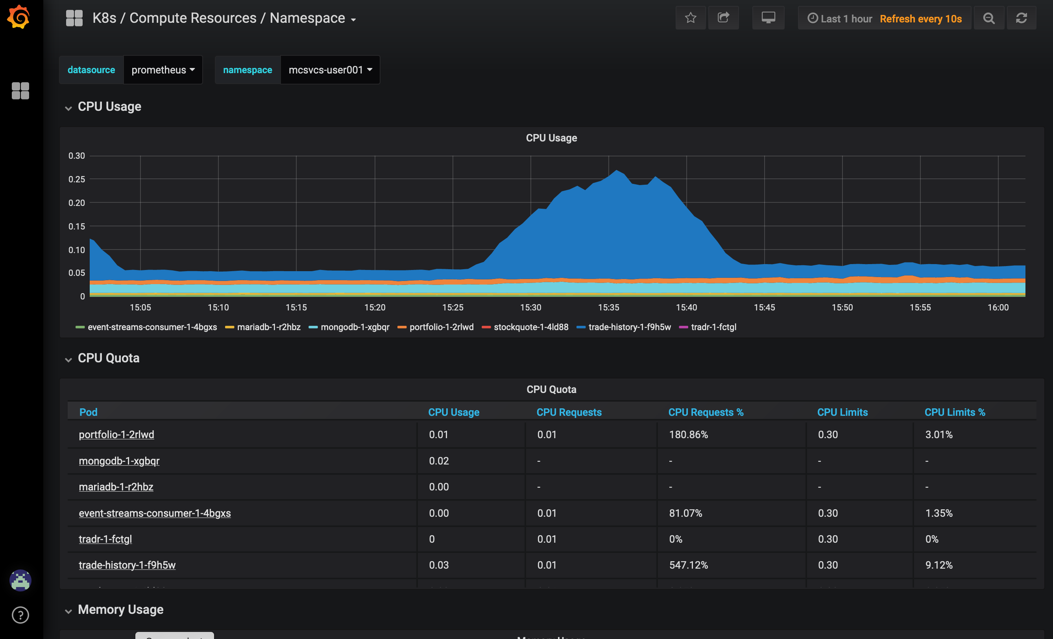
Grafana

Slide 21
When things go wrong #1
Kubernetes Logs
Problems in the container
$ oc create deployment redis --image=redis:3.2.9
deployment.apps/redis created
$ oc exec –it redis-67455bbc75-klgrg redis-cli
127.0.0.1:6379> set foo bar
OK
127.0.0.1:6379> save
ERR
$ oc logs redis-67455bbc75-klgrg
1:C 11 Nov 00:16:14.784 # Warning: no config file specified,…
…
1:M 11 Nov 00:25:32.130 # Failed opening the RDB file dump.rdb (in server root dir /data) for saving: Permission denied

Slide 22
When things go wrong #2
Kubernetes Events
Problems with the container
$ oc create deployment foo --image=busyfoo:1.9
deployment.apps/foo created
$ oc get pods
NAME READY STATUS RESTARTS AGE
foo-dcd7cd446-k85kh 0/1 ErrImagePull 0 9s
$ oc describe pod foo-dcd7cd446-k85kh
Name: foo-dcd7cd446-k85kh
Namespace: debugging
…
Events:
Type Reason Age From Message
---- ------ ---- ---- -------
Normal Scheduled 36s default-scheduler Successfully assigned debugging/foo-dcd7cd446-k85kh to 10.191.61.69
Normal Pulling 21s (x2 over 35s) kubelet, 10.191.61.69 pulling image "busyfoo:1.9"
Warning Failed 21s (x2 over 35s) kubelet, 10.191.61.69 Failed to pull image "busyfoo:1.9": rpc error: code = Unknown desc = Error reading manifest 1.9 in docker.io/library/busyfoo: errors:
denied: requested access to the resource is denied
unauthorized: authentication required
Warning Failed 21s (x2 over 35s) kubelet, 10.191.61.69 Error: ErrImagePull
Normal BackOff 8s (x2 over 34s) kubelet, 10.191.61.69 Back-off pulling image "busyfoo:1.9"
Warning Failed 8s (x2 over 34s) kubelet, 10.191.61.69 Error: ImagePullBackOff

Slide 23

Summary
Effectively managing applications in a cluster requires a “big picture” approach
Multiple application components
Cluster health / monitoring
Access control
Retention policy
Useful OpenSource tools for logging and monitoring use cases

